Slide 1
Group-19
Skill Permission Analyzer
Kalyan Karnati (kkarnat)
Vineeth Dasi (vdasi)
Akruti Sinha (asinha6)

Slide 2

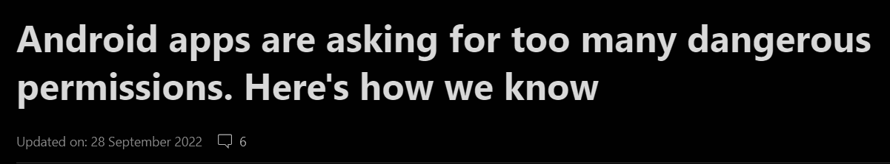
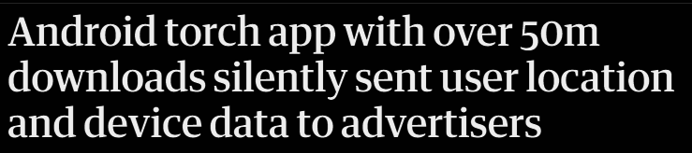

MOTIVATION
To help users make informed decisions about which apps to install and use.
To promote transparency and accountability among app developers.
To help protect users from privacy-invasive apps.
To raise awareness of privacy issues related to mobile apps.

Slide 3
PROBLEM STATEMENT
Skill Permission Analyzer:
This is an Android application that allows users to input the names of apps they use.
The app then fetches and analyzes the trackers and permissions requested by these apps
Finally, it provides users with insights into potential privacy risks associated with each app.

Slide 4
PROGRESS SO FAR
Identified the most appropriate open-source platform to help us detect behaviors that can endanger user privacy.
We built a basic app to analyze the Amazon Shopping app for permissions and trackers. We plan to scale it to accommodate all apps on the user's phone.

Slide 5
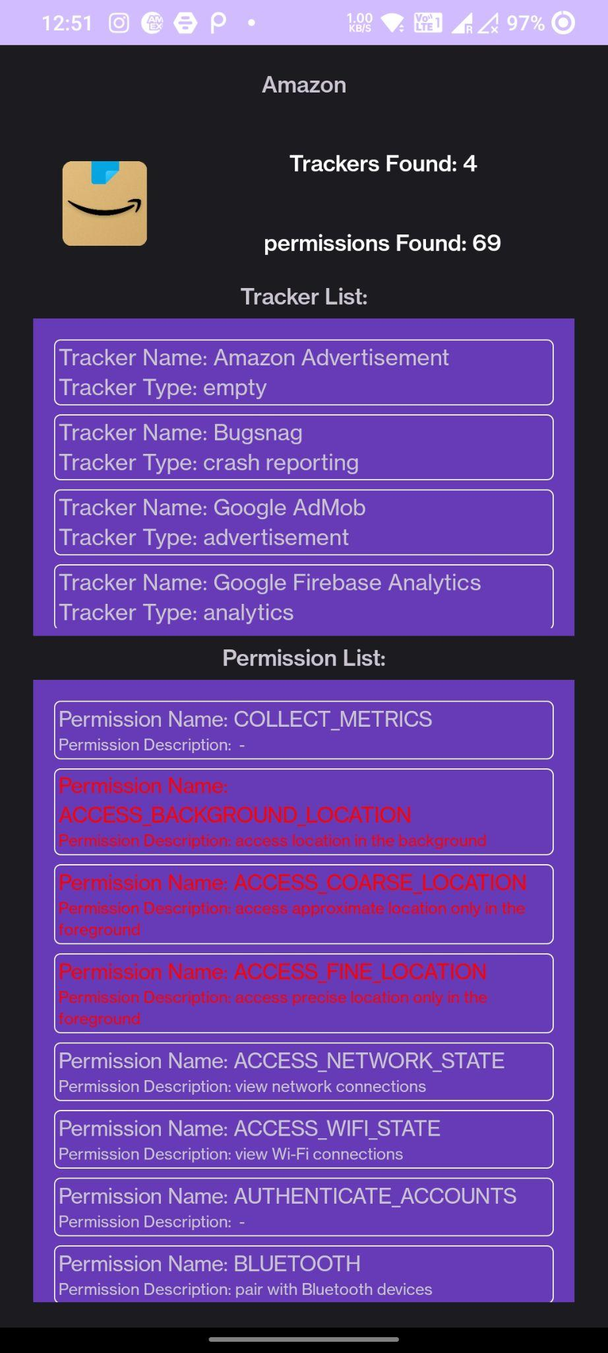
Here are some screenshots of how the app looks…
We have the information of app that has been analyzed with a count of number of trackers and permissions found within the application.
A tracker list is displayed with a list of Trackers and its types indicating the presence of tracking libraries.
A List of permissions that the app can request is shown along with the severity, the permissions highlighted in red indicate potentially dangerous as per Google’s protection levels.

Slide 6
Next Steps
As the next step, we’re planning on completing the development of the app by the second week of November.
One of our key features is the ability to provide users with insights into the trackers and permissions associated with every application on their mobile device.
To achieve this, we will access the device's app data and permission settings. On Android, we will use the PackageManager to compile a comprehensive list of installed apps and their respective permissions. This will empower users with a better understanding of how apps interact with their data.

Slide 7
Next Steps
Another significant goal is to identify and draw attention to "dangerous" permissions and display which ones users have granted to specific applications.
After development is complete, we will study the usage statistics of our beta testers to understand how they are using the app, and the insights we get from them.
Lastly, we aim to consolidate the findings and derive meaningful conclusions from them.
We also plan to include an option which blocks the third party trackers.

Slide 8
References
https://github.com/Exodus-Privacy/exodus
https://github.com/TrackerControl/tracker-control-android
https://www.mdpi.com/2624-800X/1/4/35
https://ieeexplore.ieee.org/document/6698893

Slide 9
QUESTIONS?

Slide 10
THANKS!

